Slide 1
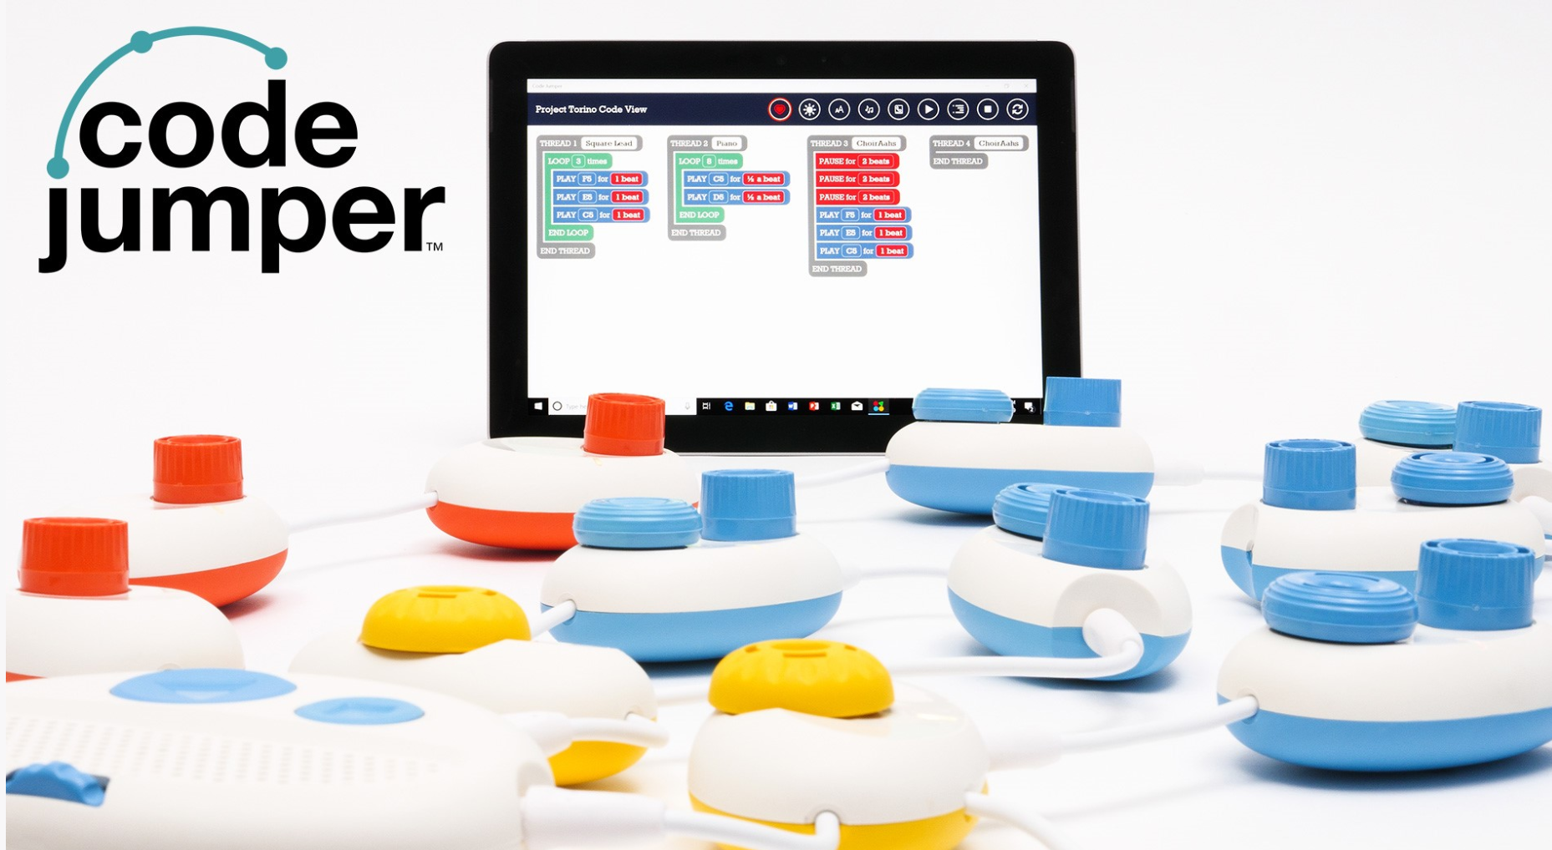
Code Jumper
Robin Lowell M.A.
Senior Manager, Accessibility, i2e
Teacher of Students with Visual Impairments
@teacherinthebox
Beth Dudycha, M.Ed.
Senior Manager, Content Development, i2e
@bethdudycha

Slide 2
Code Jumper
CJ
Alien life form
New to Earth, loves adventure
Hasn’t learned Twitter…yet

Slide 3
Coding
What is your coding experience?
0 – No coding experience
5 – Lots of coding experience
Have you used Code Jumper?
0 – No Code Jumper experience
5 – Lots of Code Jumper experience

Slide 4
Who likes Pizza?

Slide 5
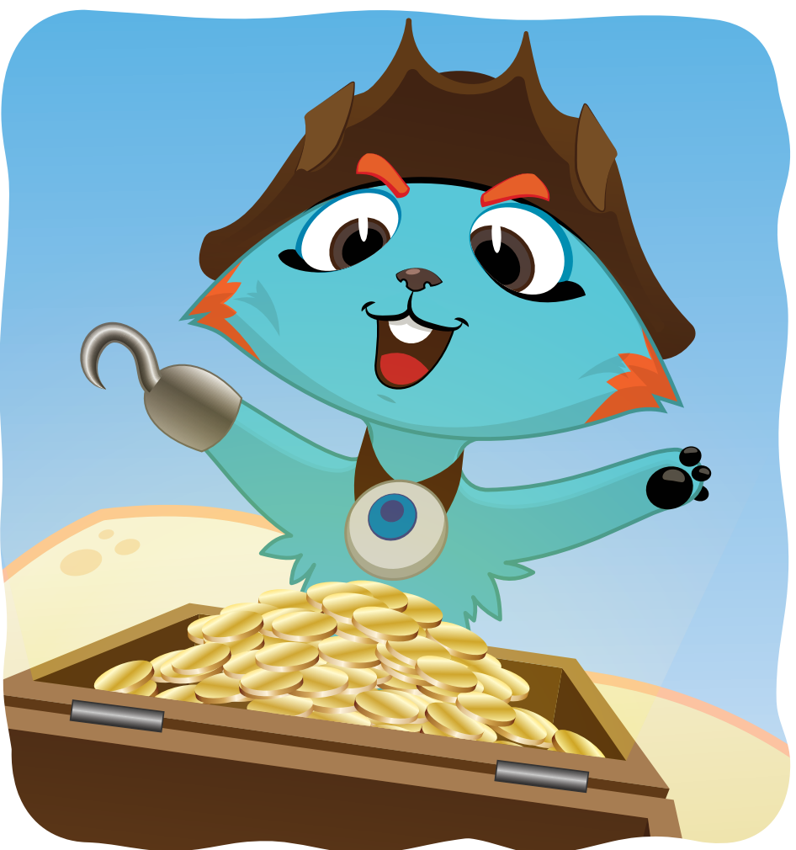
Where be the Treasure?

Slide 6
Explosion!

Slide 7
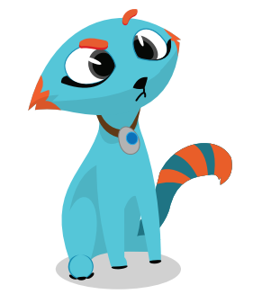
Questions:
How many jobs are there in computer science today?
What year was Code Jumper was released?
How many jobs use computers? Almost all, some, none
?
?
?
Notes:
1.4 million open positions,

