Slide 1
Printf (“Are there prerequisites to learning how to code?\r\n”;
Ken Perry

Slide 2
What is it?
How do you define programming?
Definition
The planning, scheduling, or performing of a program
The process of instructing or learning by means of an instructional program
The process of preparing an instructional program for a device (such as a computer)

Slide 3
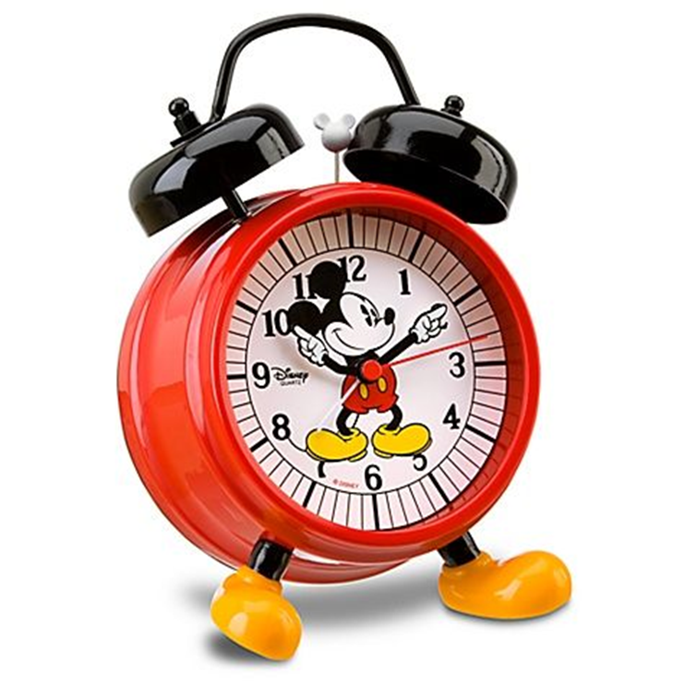
Wake up!
Notes:
Alt Text – A picture of a big old Mickey Mouse alarm clock with two bells on top.

Slide 4
Basic Skills
Step by step instructions
Spatial awareness
Alphabetization and number line
Communication skills
Understanding of math orders of precedence

Slide 5
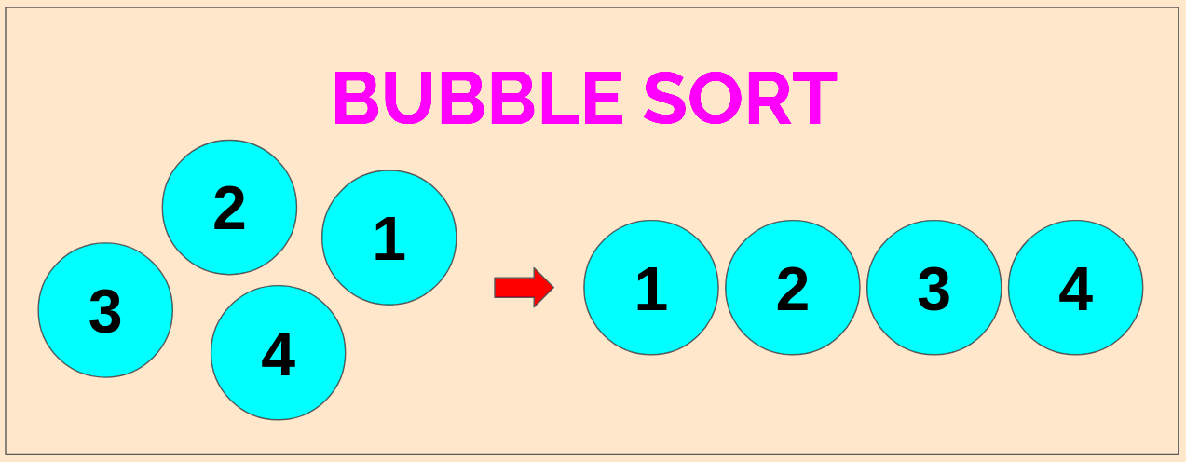
Step 1: Start
Step 2: Read the array of given items from the user.
Step 3: Take the first element (index = 0), compare the current element with the next element.
Step 4: If the current element is greater than the next element, swap them.
Step 5: Else, If the current element is less than the next element, then move to the next element.
Step 6: Repeat Step 3 to Step 5 until all elements are sorted.
Step 7: Stop
Notes:
Alt text: Picture of bubble sort showing numbers 1-4 on the left in a random grouping, transitional arrow to the right pointing to numbers 1-4 arranged in a straight line, in ascending order.

Slide 6
Input/Output
Keyboard, braille display, and/or touch screens.
Letters
Symbols
Modifiers
Screens, speakers, embosser, and/or printer.
Are there others?

Slide 7
Access Software Proficiency
Screen Readers
Magnification Software
JAWS
NVDA
Narrator
Talkback
VoiceOver
ZoomText
Microsoft Magnifier
iOS Magnifier
Notes:
Alt Text: Various screen reader and magnification software logos.

Slide 8
OS Proficiency
iOS
Mac
Windows
Linux
ChromeOS
Does the OS matter?

Slide 9
OS Extras
GUI
Command line

Slide 10
Web
Chrome
Firefox
Edge
Safari
Are web skills needed?

Slide 11
Development Environments
Notepad
NotePad++
Emacs
Eclipse
VI
IntelliJ
Visual Studio Code
Web Editors
Something else?
Does it matter which?

Slide 12
Most important skills
Inquisitiveness.
Self-motivation.

Slide 13
Thank you
Ken Perry – kperry@aph.org

