Slide 1
Peer Mentoring Community of Practice
APH ConnectCenter’s National Transition Conversation: VR Peer Mentoring and Peer MentoringWorks Program Supports.

Slide 2
Peer Mentoring
Peers are individuals who share some common characteristics, attributes or circumstances. These may relate to age, (dis)ability, interests, etc.
Peer mentors are individuals who have more experience within that common area along with additional training in how to assist another in acquiring skills, knowledge and attitudes to be more successful.
Peer Mentoring is a process through which a more experienced individual encourages and assists a less experienced individual develop his or her potential within a shared area of interest.
It is a reciprocal one in that both individuals in the partnership have an opportunity for growth and development.

Slide 3
Why Peer Mentoring?
Is the most efficient way of delivering self-advocacy the traditional teacher, Counselor or Service Provider instructs student (Youth) model? Is there a role for more experienced students with disabilities to model and mirror advocacy through a relationship built on trust and common perspective?
Evidence shows students peer mentoring students promotes success and the effectiveness of peer mentoring over traditional mentoring and classroom instruction due to shared perspective and perceived credibility. Peer mentoring has a proven track record of helping young people:
increase expectations for their future,
develop self-advocacy skills,
build personal networks, and
access important community resources.

Slide 4
VR Supported Peer Mentoring Provision
Vocational Rehab (VR) peer mentoring includes the development and employment of peer mentoring networks for young people and especially students with disabilities to support transition from school to post-secondary education and employment through the power and influence of high expectations, self-determination, and the development of self-advocacy skills.
If a State VR Agency (SCVR) uses peer mentors to provide any of the five required Pre-ETS services, can they charge the cost of the peer mentor delivering the required service to the minimum reserve requirement for Pre-ETS?
“Yes. The peer mentor in this scenario is treated in the same way as any other contracted service provider and the cost incurred providing direct Pre-ETS services that fall under any of the five required Pre-ETS activities, could be charged to the funds reserved for pre-employment transition services.” Source: WINTAC’s FAQs Pre-employment transition services

Slide 5
Building a Peer Mentoring Workforce
VR Community Employment Services Providers seeking Peer Mentor Coordinators and Peer Mentors to serve students with disabilities preparing to transition to competitive integrated employment or post-secondary educational settings.
Peer Mentor Coordinator: Preferred knowledge and/or experience in employment services provision and program administration and willing to support and guide a team of Peer Mentors to support program objectives in the direct provision of Pre-Employment Transition Services (Pre-ETS).
Peer Mentors*: Should be self-determined and be willing to share experiences, knowledge and resources for self-advocacy engagement with students with disabilities. Candidates who are self-motivated and possess qualities of leadership and are able to work independently and as part of a team under the guidance of a Coordinator to support peer mentoring program goals for students with disabilities (14-21).
*Previous work experience is NOT required. Training and background screening and work tools provided. Strong consideration to candidates experienced or familiar with self-advocacy of youth with disabilities.

Slide 6
Peer Mentor Workforce: Testimonial
“We both learned from each other in this experience. He learned dedication and patience pays off and I learned about the power of persistence.”
Wyneeta “Wyn” Kumar
FL Youth Peer Mentor at Work Opportunities Unlimited, Inc., Boca Raton, FL 2019-2020
6th Grade Teacher at Achievement First-Bushwick Charter School, Brooklyn, NY 2021 - Present
Wyneeta “Wyn” Kumar

Slide 7
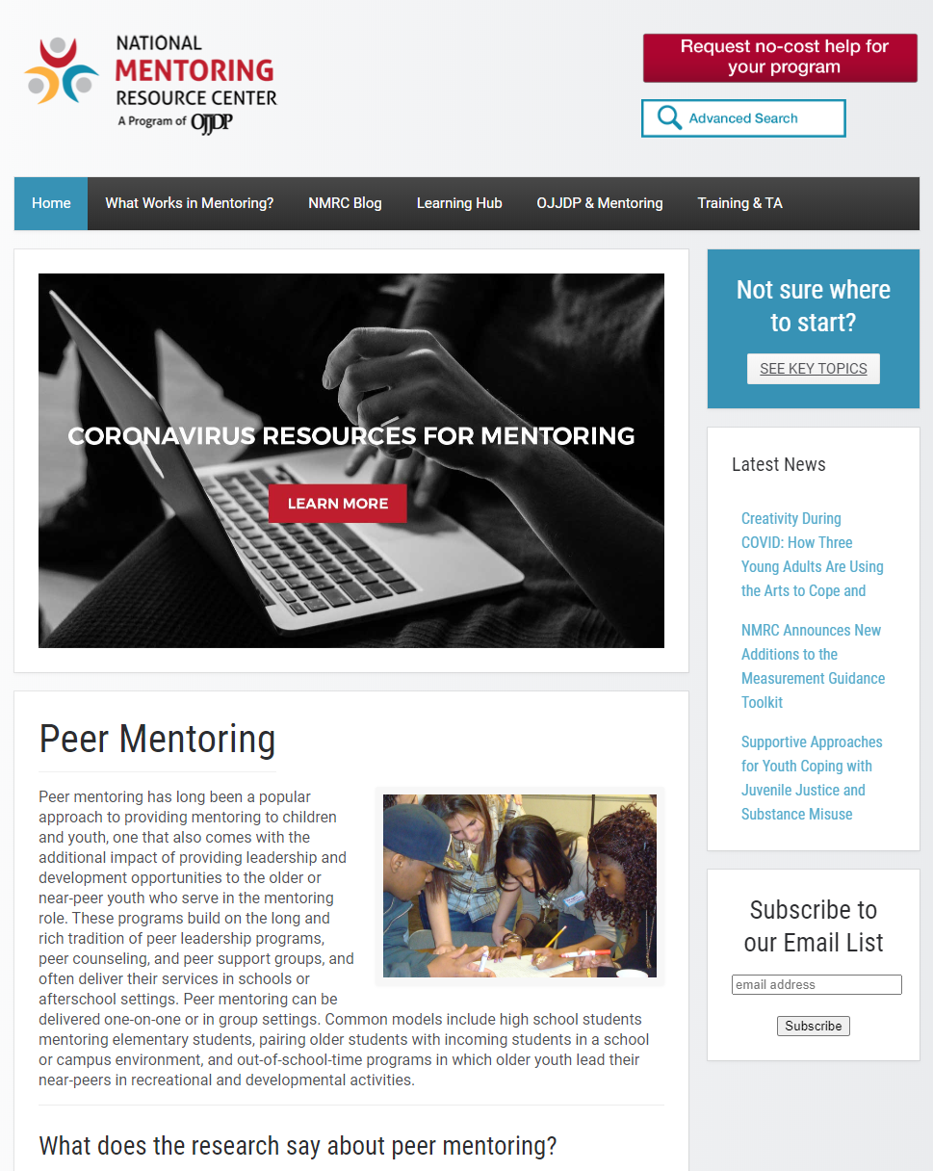
Research: Fidelity Model for Peer Mentoring Programs
How do SVRAs and Community Rehabilitation Providers turn the promise of peer mentoring into an effective practice?
In 2017, the National Mentoring Resource Center released a review that identified key findings and resources:
The most significant impacts on peer mentoring program effectiveness appear to be the mentors’ attitudes and motivations, clarity of programmatic infrastructure, and fidelity of its implementation.
The means by which programs have positive effects on mentees appears to be largely through the consistent and affirming presence of mentors, and the clarity and predictability resulting from a clear program structure.
Source: National Mentoring Resource Center’s Peer Mentoring article.

Slide 8
Peer Mentoring Program Roles
VR Program Administration
State Vocational Rehab Agency program administration staff that identify peer mentoring service fee schedules, service duration, program benchmarks, reporting standards, VR program goals (Pre-ETS and Transition Support Objectives) training protocols and provider eligibility requirements.
VR Counselors or LEA Counselors
VR or LEA Counselor: Referral Agent for student with a disability eligible for Pre-ETS Services identified to benefit from peer mentoring service
Student Peer Mentees are students (14-21) who are receiving peer mentoring support referral from the Local Education Agency or VR Counselors as a Pre-ETS Service.
Youth Peer Mentors are youth (16-24) who are receiving peer mentoring support in support of their Individualized Plan for Employment (IPE) through a referral from a VR Counselor.
Peer mentors are individuals who have more experience within that common area along with additional training in how to assist another in acquiring skills, knowledge and attitudes to be more successful.
Peer Mentor Coordinators serve as an administrative mentoring guide supporting the provision and administration of peer mentoring engagement to support fidelity and agency in service provision and program administration.

Slide 9
PMW Peer Mentoring Program Resources
PMW LearnCTR: YesLMS Training Modules
Peer Mentor Coordinator
Peer Mentor
PMW ToolSuite:
Field Guide
Activity Guides
WorkSheets
PMW TechCTR:
Design and Consultation
PMW Community of Practice (PMW CoP):
Webinars and Bi-Quarterly Meetings

Slide 10
PMW LearnCTR: Defined
What is the PMW LearnCTR?
The PMW LearnCTR is a library of training modules available on the YesLMS, an accessible learning management platform.
To-date, PMW LearnCTR is a library of 40+ unique peer mentoring program training modules. Each module includes a sequential series of lessons with a follow-up quiz.
The modules are arranged in collections that include:
PM Fundamentals
Employment Essentials / State and Community Resources
Post-Secondary
Program Supplementals

Slide 11
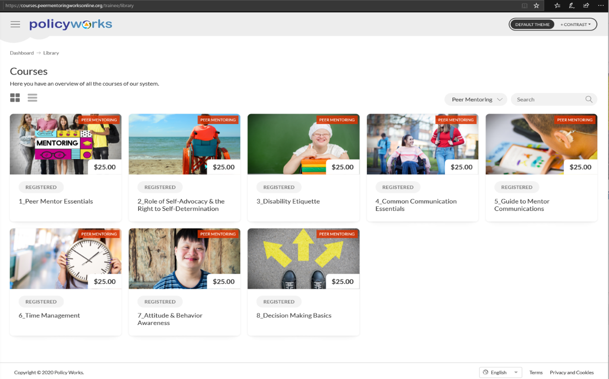
PMW LearnCTR: PM Fundamental Modules
PM Fundamentals
Peer Mentoring Essentials
Role of Self-Advocacy & Self-Determination
Disability Etiquette
Common Communications Essentials
Guide to Mentor Communications
Time Management
Attitude & Behavior Awareness
Decision Making Basics

Slide 12
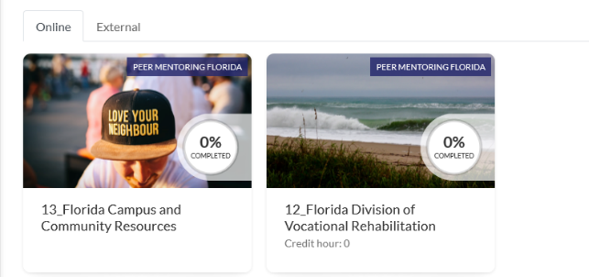
PMW LearnCTR: Transition Essentials & Resources Modules
Transition Essentials
Employment & Disability Rights
Employment & Disability Benefits
Employment & Transition Services
State/Community Resources
Campus and Community *
Division of Vocational Rehabilitation*
*AK, FL, MD, ME, MS & VA

Slide 13
PMW LearnCTR: Program Elective Modules
Post-Secondary Supplementals
Independent Living
Financial Literacy
Disability Self Disclosure
DOL/ODEP Guidepost for Success
Digital Citizenship
Attitude and Growth Mindset
APH Connect CTR?

Slide 14
PMW LearnCTR: PM Program Support
Certification Program Support
The PMW LearnCTR includes an expanding set of over 40 unique modules that may be packaged and customized for peer mentoring programs to establish competencies for the provision of peer mentoring.
Modules include alternative media formats including YouTube subject matter exploration, peer mentoring tips and techniques, completion quizzes.
Community-sourced or program specific content may be added to supplement your training protocol.
Once a SVRA identifies training requirements and PMC and/or PM completes the training requirements and testing, PMW LearnCTR staff issue a “Certificate of Completion” that may be used as part of an onboarding and training program.

Slide 15
PMW ToolSuite: FieldGuide APP/Activity Guides
What is the “PMW FieldGuide”?
PMW FieldGuide is an accessible web-based/mobile APP (available at App Store or Google Play) featuring an on-demand “mentoring program handbook” available in the field for the direct provision of peer mentoring practice.
“There is an App for that!!!”

Slide 16
PMW ToolSuite: FieldGuide APP/Activity Guides
What is the “PMW FieldGuide”?
PMW FieldGuide is an accessible web-based/mobile APP (available at App Store or Google Play) featuring an on-demand “mentoring program handbook” available in the field for the direct provision of peer mentoring practice.
“There is an App for that!!!”

Slide 17
PMW ToolSuite: FieldGuide Features
Features
Navigation Dashboard – Expandable and Collapsible Menu Interface
Mobile APP/PC Desktop Functionality – User account accessed “My favorites” and “My Recent” bookmarks and App Share; Usage Data
On-demand Mentoring Tools and Content
PMW ActivityGuides
PMW AbleSheets - Downloadable/Printable/Emailable Products
PMW Program Supports
PMW Tools - SSI Benefit Calculator
PMW Learn CTR - Multimedia Content
Customizable expansion available through PMW TechCTR

Slide 18
PMW ToolSuite: ActivityGuides
PMW ActivityGuides
The PMW ActivityGuides are a growing collection of ‘Subject Matter’ guides available through the PMW FieldGuide for a Peer Mentor to employ in direct one-to-one or group peer mentoring session. Each ActivityGuide includes:
Peer Mentor Guidance
Activities with Supported Worksheets
Impact Assessments
Supported by Learn CTR Training and Program Resources
Current examples include the Networking, Disability Disclosure Digital Citizenship PMW ActivityGuides.

Slide 19
PMW ToolSuite: WorkSheets
Download-able; edit-able; save-able; share-able; print-able; and email-able
Work sheets and fillable forms are available through the PMW FieldGuide and may include program specific resources to support peer mentoring objectives.
The expanding library of PMW FieldGuide content is download-able; edit-able; save-able; share-able; print-able; and email-able.
These tools are designed to provide fidelity and agency to the provision of peer mentoring support.
The PMW TechCTR is available to work with agencies and program administrators to customize the resources available through the PMW FieldGuide.

Slide 20
PMW TechCTR: Program Support
Program Design and Implementation Support
The PMW TechCTR is available to assist State Vocational Rehabilitation Agencies (SVRA) and related programs and agencies supporting youth, student and young adult transition through peer mentoring.
PolicyWorks, through its technical support team and resources, bring experience and support services developed as the legacy of the WINTAC.
The Peer MentoringWorks CoP, its LearnCTR and ToolSuite are available to support the design and implementation of peer mentoring programs as an inclusive transition support to individuals with disabilities.
Join the PMW CoP and access resources to design and implement your peer mentoring program.

Slide 21
PMW Community of Practitioners (CoP)
Peer Mentoring Works CoP
The PMW CoP connects a network of peer mentoring providers for the purpose of mentoring other providers to develop and expand peer mentoring programs as a VR service. The PMW CoP seeks to:
Support Peer Mentoring Services: advocacy, efficacy and determination
Identify emerging best practices
Capture and share early success stories
Build a library of resources and technical assistance materials
Explore the development of new tools and practices

Slide 22
Contact
Join us for our PMW
Community of Practice Meeting on March 24th, 2021
Hosted on Zoom 1:00-2:30pm EDT
Steve Allen, President PolicyWorks
1.Steven.Allen@gmail.com
850-879-2631
www. peermentoringworks.org
www.disabilitypolicyworks.org
Visit Peer MentoringWorks Online
www.peermentoringworks.org

